Slide 1

Food Safety
Why do we need to know about food safety?
What is food safety?
High and low risk foods
Personal hygiene
Basic hygiene
Food preparation
Means of cooking – additional considerations
Allergy awareness
Religious and cultural awareness
Sharing this information
Where to get help

Slide 2

Why do we need to know about food safety?
Think about all the ways that you might use food in your sessions. Do you:
Provide snacks?
Have members who bring a snack or packed lunch?
Host parties where members or volunteers bring their own food?
Provide historic food tasting for members?
Lead historic cooking activities?
If you answered yes to any of these, you need to know about food safety.

Slide 3

What is food safety?
The procedures to ensure good practice in food preparation, handling and storage to prevent foodborne illness and injury.

Slide 4
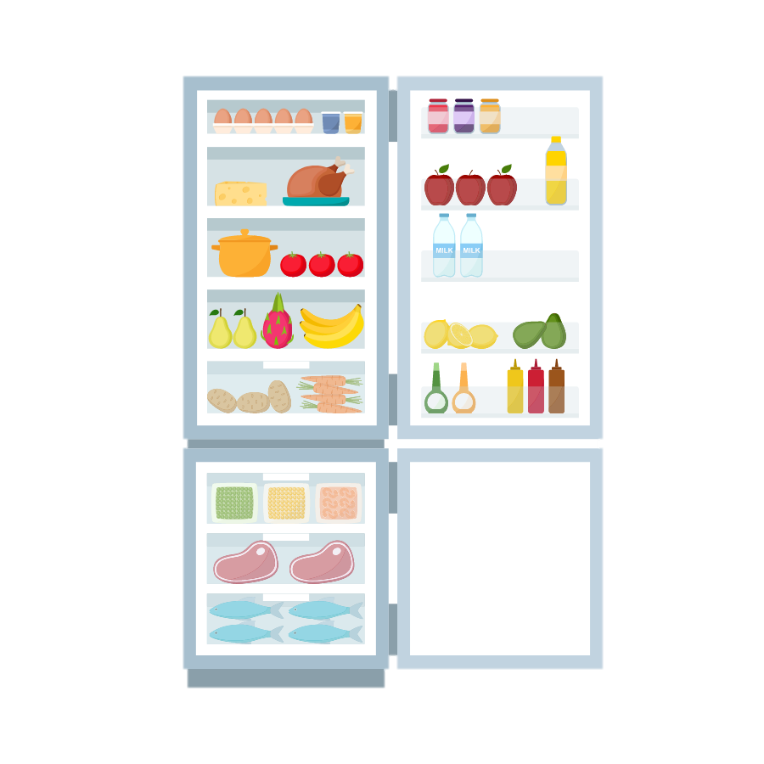
High and Low Risk Foods
Low Risk foods are stable at room temperature and include:
foods that have been preserved, for example, smoked or salted fish
dry goods, those that contain minimal amounts of moisture, such as bread, flour, biscuits
acidic foods, for example, pickled foods, vinegar, fruit
fermented products such as salami, pepperoni
foods with high sugar/fat content, for example, jam & chocolate
unopened tinned food
High Risk foods are usually high in protein, need to be temperature controlled and protected from contaminants. They include:
cooked meat and poultry such as beef, pork, ham, chicken.
cooked meat products such as meat pies, pasties and pate.
dairy products such as milk, cream, custards, and ripened soft & moulded cheeses
egg products such as cooked eggs, quiche, mayonnaise, mousse and home-made ice cream
shellfish and other sea-foods
starchy dishes including cooked rice, pasta and couscous

Slide 5

Personal hygiene
Your role in food safety includes personal hygiene:
avoid touching your face or nose and coughing or sneezing over food
ideally, you shouldn’t wear watches or jewellery when preparing food
make sure your clothes are clean and ideally wear an apron
do not prepare food if you have diarrhoea and/or vomiting or within 48 hours of your symptoms ending
ensure that any cuts or sores are completely covered with a waterproof dressing, ideally a brightly coloured one
tie back long hair
wash your hands with soap and running water

Slide 6

Basic hygiene
Ensure that:
any and all food preparation areas (work surfaces, equipment, utensils, etc.) are cleaned and disinfected
there are plenty of handwashing and cleaning materials (soap, paper towels, cloths, etc.) available
any and all fridges, chilled equipment and freezers are working properly or a cool box is available when required (especially when transporting food)
any and all other equipment (e.g. oven, utensils, etc.) and including historical replicas are in good condition and working properly.
food is stored correctly, as per the label and directions (e.g. in a fridge/cool box, covered container and not left out for too long)
food is used within its ‘use by’ or ‘best before’ dates
waste, including food waste, is disposed of
laundry of dirty cloths, aprons, etc. is undertaken
you check for signs of pests (e.g. mouse droppings)

Slide 7
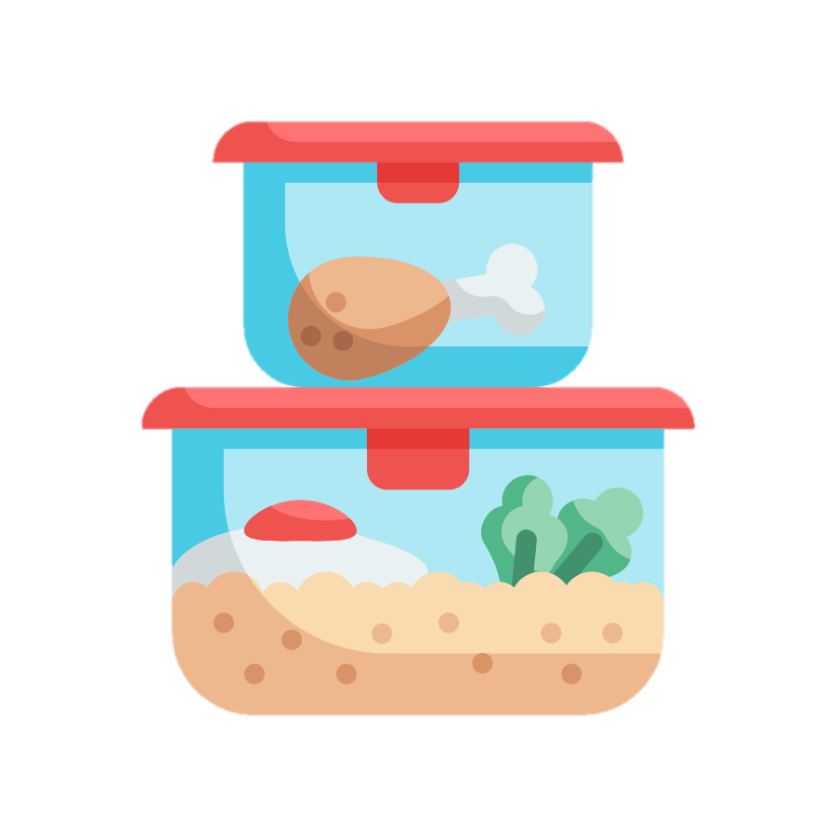
Food preparation
Do:
buy food and/or ingredients in good time (e.g. fresh products on the day of use)
store/transport food and/or ingredients safely (e.g. in a cool box)
keep raw and cooked foods in separate containers.
keep all raw meat at the bottom of the fridge to avoid drips.
use separate knives and chopping boards for raw and cooked food.
wash all fruit and vegetables.
check cooking/reheating instructions carefully and ensure that all food is cooked through.

Slide 8
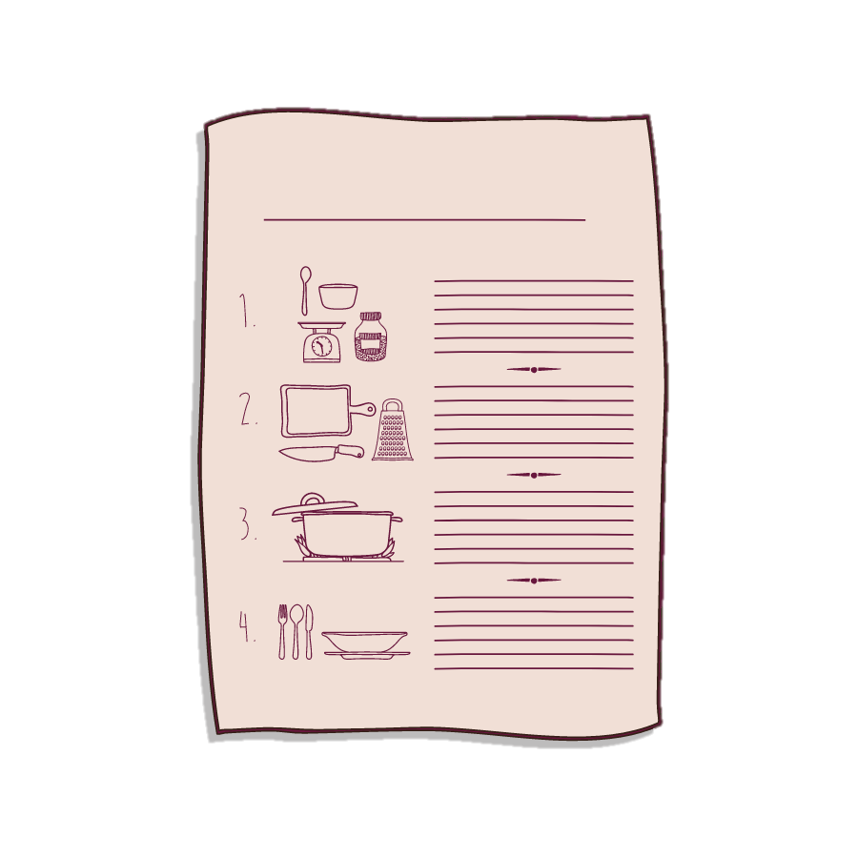
Food preparation contd.
Don’t
allow animals into the food preparation areas
make food too far in advance
leave food standing around for long periods in warm places
use raw eggs in uncooked food, such as chocolate mousse
If you cannot guarantee adequate hygiene when preparing food then whatever is produced should not be eaten.
Instead, you could give your members a recipe to try cooking at home or make some samples yourself in advance for them to taste.

Slide 9

Means of cooking or serving food – additional considerations
Consider how you might ensure food safety depending on how and where you will be preparing and/or serving food.
How are you going to cook or prepare the food?
In a professional kitchen?
In your own kitchen at home before the session?
On an open fire or barbeque outdoors?
In a historic or historic style oven or range?
On a gas camping or electric hob?
Where are you going to serve the food?
In an indoor venue close to hand washing facilities?
Outside, on a field walk or at an excavation site away from handwashing facilities?

Slide 10

Allergy Awareness
Under UK food law, there are legal requirements to label and/or provide ingredient information when providing food to others in a business context.
There are 14 main allergies named in food law:
celery
cereals containing gluten (e.g. barley and oats)
crustaceans (e.g. prawns, crabs and lobsters)
eggs
fish
lupin
milk
8. molluscs (e.g. mussels and oysters)
9. mustard
10. peanuts
11. sesame
12. soybeans
13. sulphur dioxide and
sulphites (at a concentration of more
than ten parts per million)
14. tree nuts (e.g. almonds, hazelnuts, walnuts, brazil nuts, cashews, pecans,
pistachios and macadamia nuts).
While these are the named main allergens, people can be allergic to any food item.

Slide 11

Can you recognise the common symptoms of food allergies?
Tingling or itching in the mouth
A raised, itchy rash (hives) or the skin becomes itchy, red, dry and cracked
Swelling of the face, mouth, throat or other areas of the body
Difficulty swallowing
Wheezing or shortness of breath
Feeling dizzy or lightheaded
Feeling nauseous or vomiting
Abdominal cramps or diarrhoea
Hay-fever like symptoms
Colic (especially in babies)
The most severe allergic reaction is anaphylaxis, which can start with any of the symptoms above and progress rapidly to collapse. If this occurs call 999.

Slide 12
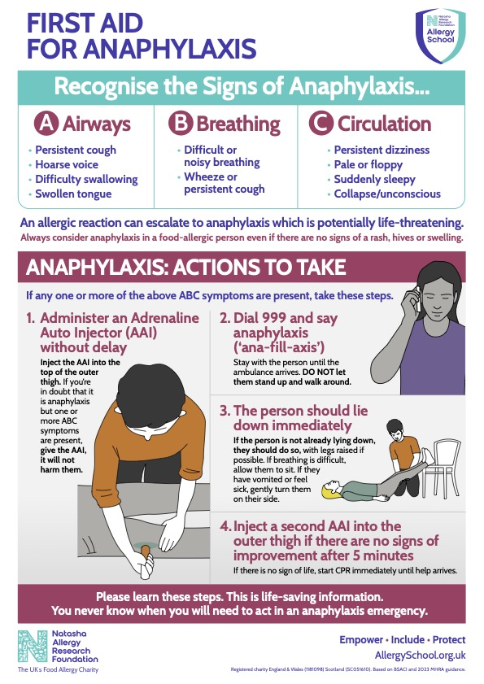
First Aid for anaphylaxis
Allergy School provide a downloadable poster with simple instructions for administering first aid for anaphylaxis.
Young people with severe allergies should carry an epi-pen. There are two types of AAI, Epipen and Jext:
Epi-pen AAI Instructions
Jext AAI Instructions

Slide 13

What can we do to support members and volunteers with food allergies?
Ask your members and their parents/carers what they can and cannot eat. This information should be on their membership form and, in the case of a known (severe) reaction in their Individual Support Plan.
Make sure you keep allergens separate from other foods; even a tiny trace amount can cause a reaction.
Check the ingredients list on prepacked foods for allergens.
There are often good substitutes for allergens available to buy. This could be individual ingredients for a recipe or pre-packaged Freefrom biscuits and cakes.
Avoid cross-contamination by:
  cleaning work surfaces and equipment thoroughly to remove traces of food you may have cooked or prepared before.
  asking that specific items aren’t used or brought to a session, especially if controlling contamination is difficult to manage or the allergy is extremely severe.

Slide 14

Other considerations with food allergies?
Remember:
Food allergens can be found in unexpected places (e.g. vegetable oil often contains peanut oil)
Food allergens may also be contained in other substances (e.g. citrus in cleaning chemicals; almonds in soap)
Food allergens may be given an E-number instead of being named (e.g. soybean hemicellulose is E426)
We can only plan for what we know about – an allergy can develop or change in severity at any time.
Food intolerances aren’t allergies, however if known and disclosed to you then they should be planned for as they do cause discomfort.

Slide 15

Religious and Cultural Awareness
Some religions and cultures have strict dietary requirements; these may have an impact on the type of food you serve or make and include:
how foods are prepared e.g. Halal or Kosher
what foods may or may not be eaten e.g. pork and beef
when food might be eaten e.g. observing religious festivals and fasts
Top tips for considering religious and cultural requirements:
Ask the member and their parent/carer for guidance.
Make substitutions to recipes e.g. use vegetable suet instead of beef suet.

Slide 16

Sharing this information with volunteers
There are many ways in which all YAC volunteers can be involved in the risk management for your branch and sessions.
Some ideas are:
Ensure that all volunteers are aware of basic food safety.
Send your recipe, instructions, ingredients list and risk assessment to all the branch volunteers for comments before the session.
Ensure that the recipe, instructions and ingredients list are available during the session.
Hold a pre-session briefing to go over the recipe and key control measures, including use of equipment and identifying anyone with known allergies.
Discuss any thoughts, incidents or near misses after the activities/session to improve safety in the future.

Slide 17

Sharing this information with children
Top tips include:
Use words and symbols when labelling food, especially for food allergies.
Can you create a ‘recipe card’ using words and pictures for each step?
What language are you using? Can you use descriptive instructions or questions to foster awareness, or questions to help them understand why you are doing certain actions at different times and how you are preparing the food.
Tailor your language to the age and ability of your members.
Where you know that there is a member with a severe allergy can you display a poster and promote an allergy aware environment?

Slide 18

Sharing this information with parents/carers
There will be times when parents/carers will require additional information regarding food and cooking activities, especially regarding allergies and dietary requirements, religious or cultural considerations, or how you are preparing food.
Some ideas are:
send a letter/email to all parents/carers
have a chat with them at the beginning or end of the session, especially if there might be special considerations (e.g. allergies or religious and cultural considerations)
display a simple poster where parents/carers can see it easily and clearly
Always be prepared to answer questions, be open to feedback and to share risk assessments if requested.

Slide 19
Where to get help
YAC HQ
Safer food, better business for childminders | Food Standards Agency
Allergy School – Resources for Out of School Settings
Local environmental health

