Slide 1




Slide 2


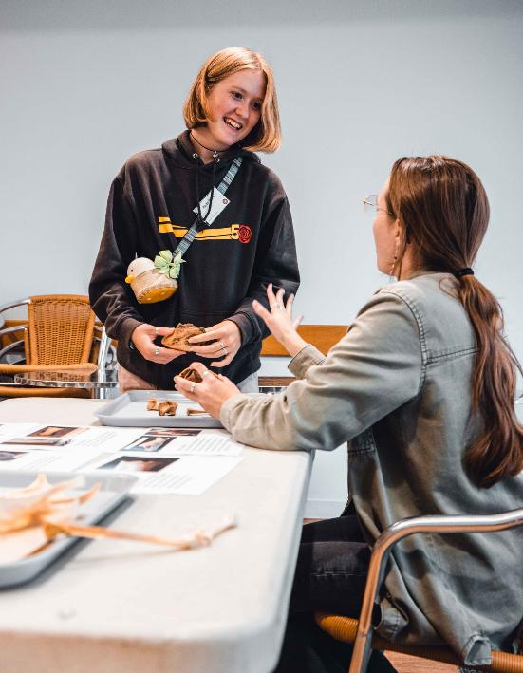
Thank you for expressing an interest in becoming a YAC Young Leader!
In this session we will cover:
  What does a YAC Young Leader do?
  The requirements of being a YAC Young Leader
  The benefits of becoming a YAC Young Leader
  Support from your YAC Branch Leaders
  Conduct and expectations
  How to apply

Slide 3
What is a YAC Young Leader?
YAC Young Leaders are volunteers aged 16-17 who regularly help run their local YAC branch sessions. A Young Leader could be an existing member who is looking to stay involved in YAC when they are too old to stay on as a member.
As a Young Leader, you have the option of completing a Progression Passport to record your volunteering journey with YAC, set goals and provide great evidence for college, apprenticeships, job applications, or future volunteering!
You will also be assigned a mentor within your YAC branch team who will give you ongoing support and guidance as you grow as a Young Leader.

Slide 4
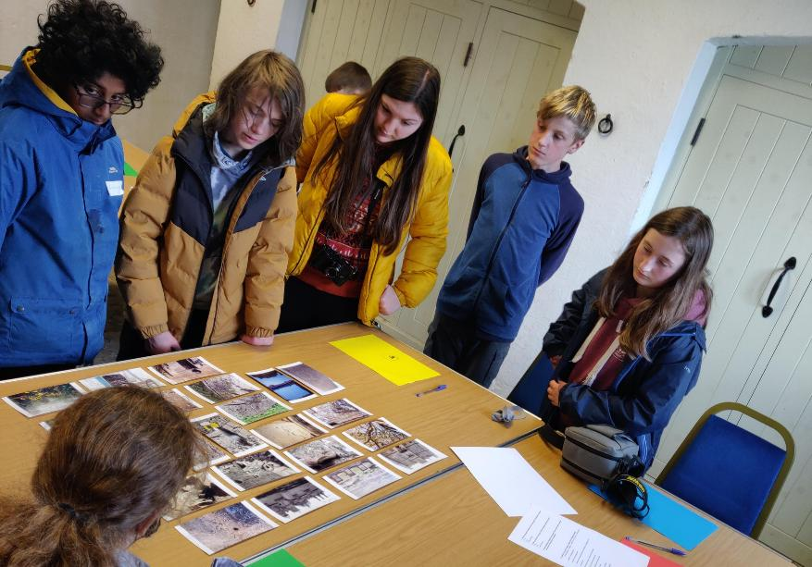
What does a Young Leader do?
The precise tasks and activities carried out by a Young Leader will vary depending on:
1) the individual Young Leader’s interests and goals, as discussed with your Mentor, and
2) the YAC branch’s programme of activities, resources and capacity.

Slide 5
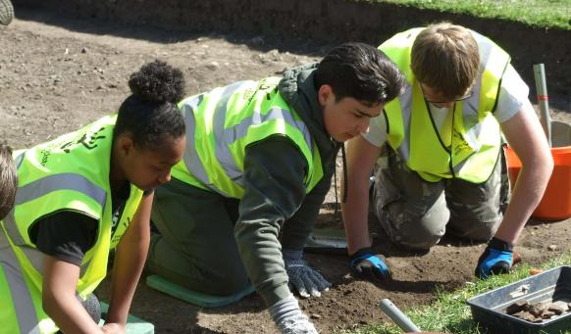
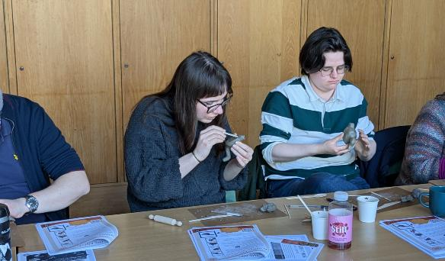
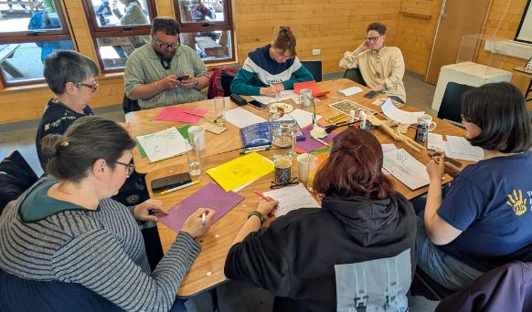
What does a Young Leader do?
You might start by observing and assisting with sessions, helping with simple tasks such as setting up activities, supporting members, or demonstrating something you’ve learned.
Over time, you might have opportunities to plan parts of a session, lead small groups and contribute ideas.

Slide 6
The overall responsibilities of a YAC Young Leader are:
1
2
Helping the Branch Leaders and Branch Assistants to plan and deliver activities for members aged 8-16.
Acting as a role model for YAC members aged 8-16.
3
4
Assisting members with activities such as archaeological tasks, challenges and crafts.
Arriving on time to YAC sessions and helping to set-up and pack-down activities.

Slide 7
The overall responsibilities of a YAC Young Leader are:
5
6
7
Following the instructions and guidance of the YAC Leader and communicating promptly and professionally with the YAC team.
Completing a Safeguarding Induction with the YAC branch leader.
Observing the YAC Code of Conduct at all times.

Slide 8
What skills will I gain as a YAC Young Leader?
Working in a team
Leadership skills
Planning and running activities
Communicating with people of different ages and abilities
Time-keeping
Responsibility

Slide 9
What knowledge will I gain as a YAC Young Leader?
Working with young people
Health and safety
Safeguarding children
Archaeology!

Slide 10
Using the Progression Pathway
You will have the opportunity to meet regularly with your Mentor to talk about your progress and goals and complete your Progression Pathway.
Your Progression Pathway is a simple record of your journey. You’ll use it to:
  Track the activities you've helped with
  Reflect on what you've learned
  Identify soft and hard skills that can support future applications for higher education, work experience/placement opportunities and more
  Set new goals with your Mentor
  Record achievements for school, college or future opportunities
  Gain certificates for key milestones and achievements.

Slide 11
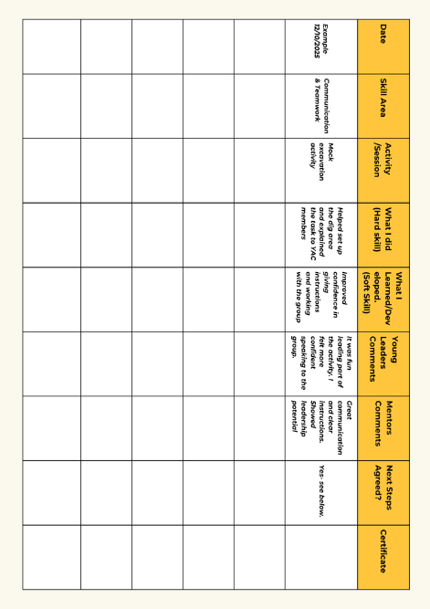
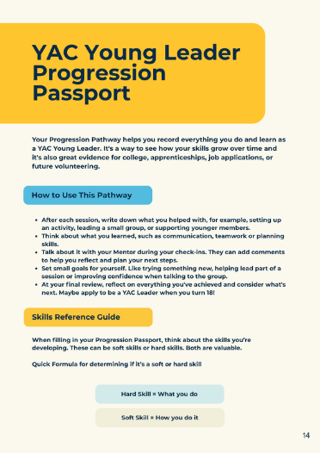
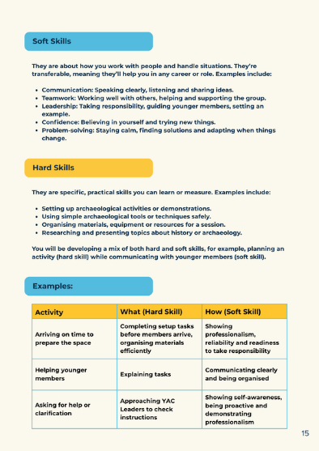
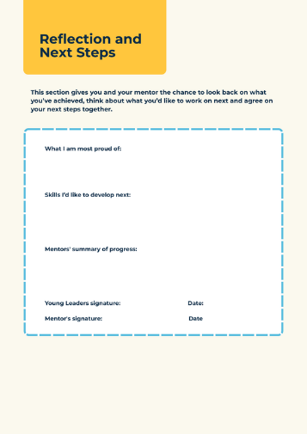
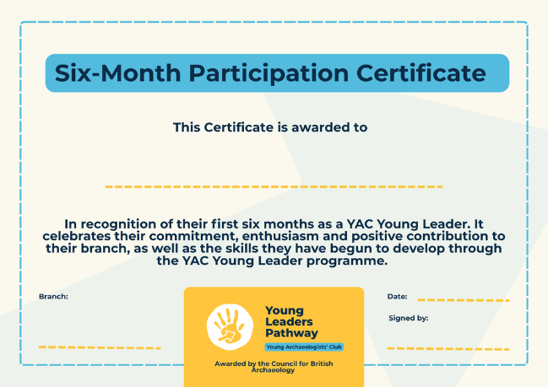
Using the Progression Pathway
Table for recording notes from your mentoring meetings.
Certificate example
Progression Passport - guide to identifying skills and recording your progress.

Slide 12
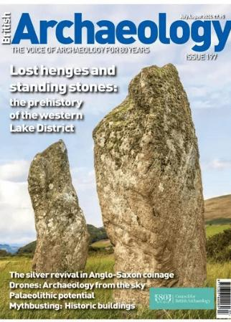
What are the other benefits of being a YAC Young Leader?
You will also receive two years of free digital membership with the Council for British
Archaeology,
which includes
access to British
Archaeology
magazine.
When you turn 18, you may be able to apply to become a YAC Branch Assistant and take on more responsibility within your branch. It’s a great next step if you’ve enjoyed volunteering and want to stay part of the YAC community as an adult volunteer!

Slide 13
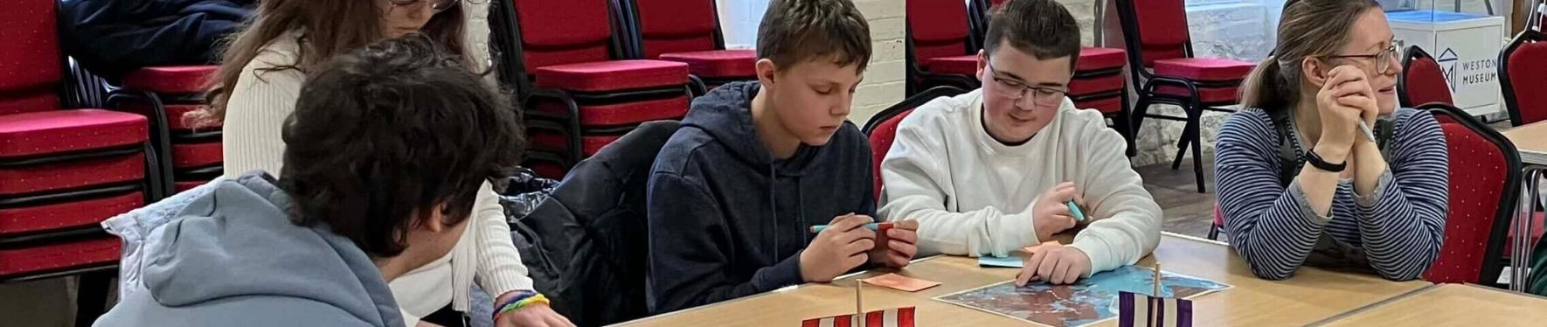
How long is the YAC Young Leaders programme?
YAC Young Leaders are age 16-17. This means that if you start when you turn 16 the programme is two years. If you start later the programme will be shorter.
When you turn 18 you are no longer a YAC Young Leader. You can potentially apply to be a YAC Branch Assistant or move on from your YAC branch.

Slide 14
What are the requirements of being a YAC Young Leader?
Young Leaders must be 16-17 years old. We’re looking for individuals who:
Are enthusiastic about archaeology and history.
Are keen to learn new things and develop their skills.
Enjoy working with children.
Are willing to work in a team.
Will follow the instructions and guidance of the YAC Leader.
Understand the importance of following YAC’s Code of Conduct and safeguarding policy.
Can commit to attending monthly YAC sessions regularly.

Slide 15
Please note:
YAC branches can only accept a limited number of Young Leaders. This is because we need to follow a strict ratio of adults:children to keep everyone safe. As under-18s, Young Leaders count as a children in this ratio.
YAC Branch Leaders work very hard to run their clubs and may not be able to support multiple Young Leaders at once.
If your YAC branch cannot take you on as a Young Leader then you will no longer be able to keep coming to the club when you turn 17.
They may talk to you and your parents/carers to recommend other volunteering opportunities that might be right for you instead.

Slide 16
Conduct and expectations
Being a YAC Young Leader is not the same as being a mature member. You will be a volunteer and part of a team. There are some important considerations that will shape how you behave around YAC members. Your YAC Branch Leader will talk to you about the following:
1) Safeguarding
Safeguarding is everyone’s responsibility, and your awareness helps keep the YAC a safe and positive space for everyone. Your YAC Branch Leader will run an induction session to introduce you to our Safeguarding Policies and explain what this means. They will help you understand some important Do’s and Don’ts to help you keep everyone safe, supported and respected during activities.

Slide 17
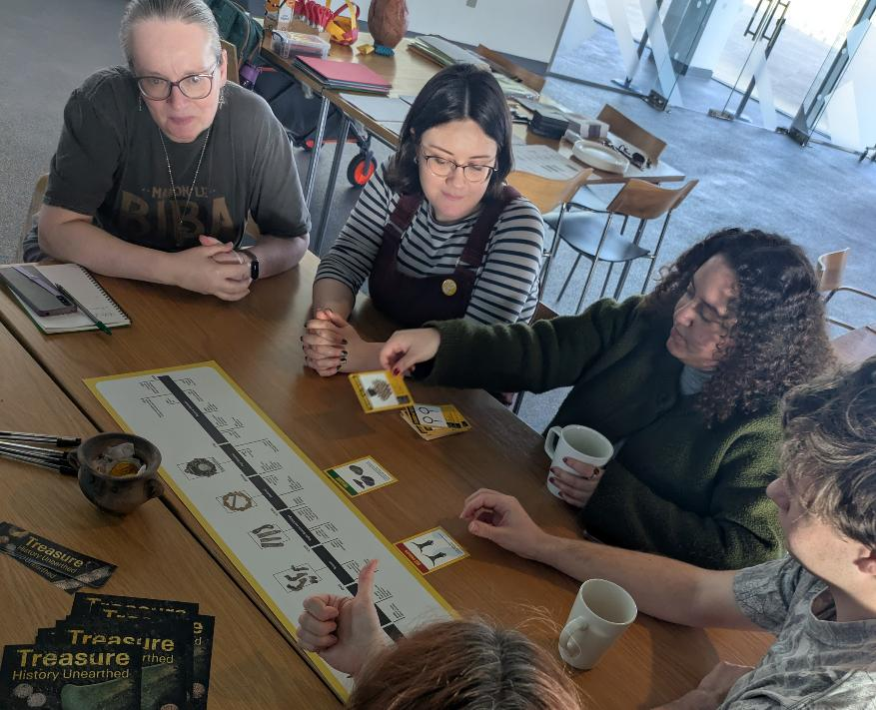
Conduct and expectations
2) Conduct
As a Young Leader, you’re a role model for younger members. Your Branch Leader will read through the Code of Conduct with you. This is a list of shared values that guide how we work together during all YAC sessions. They help create a safe, welcoming and positive environment where everyone can contribute, learn and feel supported.

Slide 18

Conduct and expectations
3) Communication
You will be expected to communicate promptly and professionally with your YAC branch team. There are also some important rules about communicating with members, including using social media and private messaging, as part of our Safeguarding policy.

Slide 19

Conduct and expectations
4) GDPR
GDPR is a set of rules that helps keep everyone’s personal information safe. You don't need to know the law in detail; you just need to understand how to handle information responsibly. Your YAC Branch Leader will talk to you about how to keep information private and the rules around taking photos/videos.

Slide 20
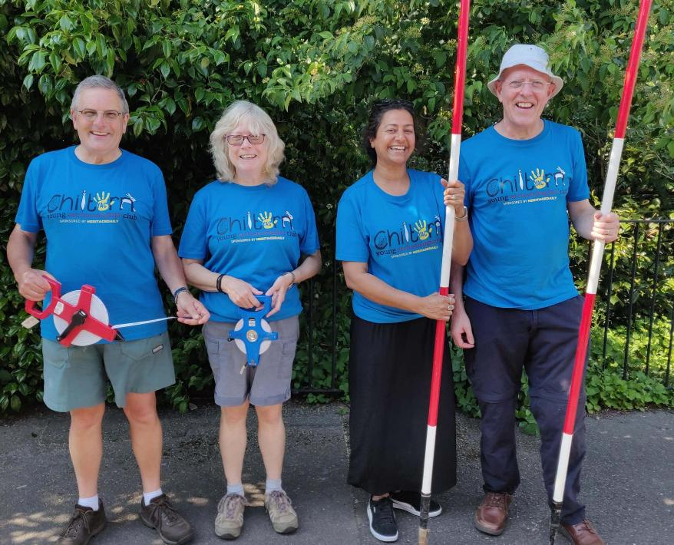
Conduct and expectations
5) Commitment
YAC Young Leaders are expected to attend club sessions regularly, in addition to extra meetings with the branch leadership team. However please talk to your Branch Leader if you need to take a break when life gets busy, such as during exams.

Slide 21
What to do if you are interested in becoming a YAC Young Leader?
1. Attend a session as an observer
You will be invited to attend a YAC session to see how the club operates from the perspective of a Young Leader and volunteer.
2. Have a follow-up conversation
After the session, your Branch Leader will meet with you to discuss how your YAC branch works and what being a Young Leader involves.
3. Decide if you would like to apply
Once you have had the chance to observe and learn more, you can decide whether you would like to take the next step and formally apply.

Slide 22
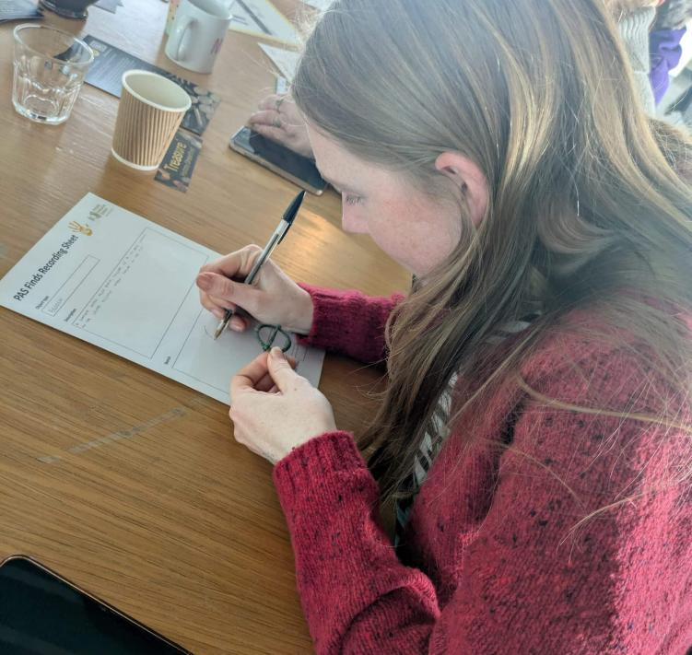
The application process
If you decide to apply, you will be sent a link to an online application form. It’s simple and will ask you:
  Your name, date of birth, contact details and pronouns
  Why you would like to volunteer with YAC
  Any experience that you feel is relevant (e.g. if you have been a YAC member before, what your interests are).

Slide 23
References
The application form will ask you for the contact details for two references:
  One must know you for at least a year, and the other for two years.
  If you have been a YAC member for over six months, you can ask your branch leader if they would be happy to be one of your references.
  Your references could be teachers, youth workers or other adults who know you well.
  References must not be family members.
Make sure to tell your referees that the Council for British Archaeology (CBA) will be in touch. Overseas references are also accepted.

Slide 24
DBS/PVG checking
If your YAC branch is in Scotland, you will need to complete a PVG (Protecting Vulnerable Groups) check. This is a simple background check that helps make sure everyone taking part in YAC activities is safe. It is free for volunteers and only needs to be undertaken once while you are working as a YAC Young Leader. Please speak with a member of the branch for more information.
Volunteers aged 16-17 in England, Wales or Northern Ireland do not need DBS/Access NI checks. However, if you stay on at your branch as a Branch Assistant when you turn 18 you will need to complete a DBS/Access NI check at that stage.

Slide 25
The approval process
Your application form and references will be reviewed by the YAC Approval Panel. Once your YAC Leader has invited you to apply and you have completed the application form, it will usually take 6-8 weeks for your application to be approved.
When the Aproval Panel have approved your application, the CBA will send you, your parent/carer and your Branch Leader an Approval Letter by email to confirm that you have been approved as a Young Leader.
You will also be provided with a Welcome Pack which includes role information, key contacts, training requirements and practical guidance to help prepare you for your role as a Young Leader.

Slide 26
Useful links
Young Leader role description: https://www.yac-uk.org/join-a-club/young-leaders-pathway/yac-young-leader-role-description/
YAC Safeguarding policies: https://www.yac-uk.org/run-a-club/safeguarding/
YAC Code of Conduct: https://www.yac-uk.org/run-a-club/safeguarding/safeguarding-code-of-behaviour/
Our Designated Safeguarding Lead: Jo Kirton - joannekirton@archaeologyuk.org / 07738591744 / 01904 521233

Slide 27
Thank you for listening! Any questions?

