Slide 1

Writing your risk-benefit assessment
Why we write risk-benefit assessments
What should be in a risk-benefit assessment?
What is a hazard?
Deciding on the risk
What is risk-benefit?
Identifying control measures
Review
Where to get help

Slide 2

Why we write risk assessments
To help us think through our activities, venues and sessions.
To help protect ourselves and others from harm.
So that our activities and sessions are covered by YAC’s insurance.
To meet the legal obligations of yourselves and YAC with regard to health and safety.

Slide 3

What should risk-benefit assessments contain?
The minimum amount of information that you need in a risk assessment is:
the hazards (things that may cause harm)
how they may harm people
what you are already doing to control the risks

Slide 4

What should risk-benefit assessments contain?
Managing risk within your YAC activities is about finding the balance between risk and benefit.
YAC assessments also look at the learning benefits of an activity.
Your risk assessment then uses a comparison of the benefits (e.g. teaching a new skill, developing good practice) and the level of risk, to determine if the benefits outweigh the risk.
Therefore, with good control measures in place, you might decide to lead an activity that is of higher risk because the learning benefits of the activity is strong.

Slide 5
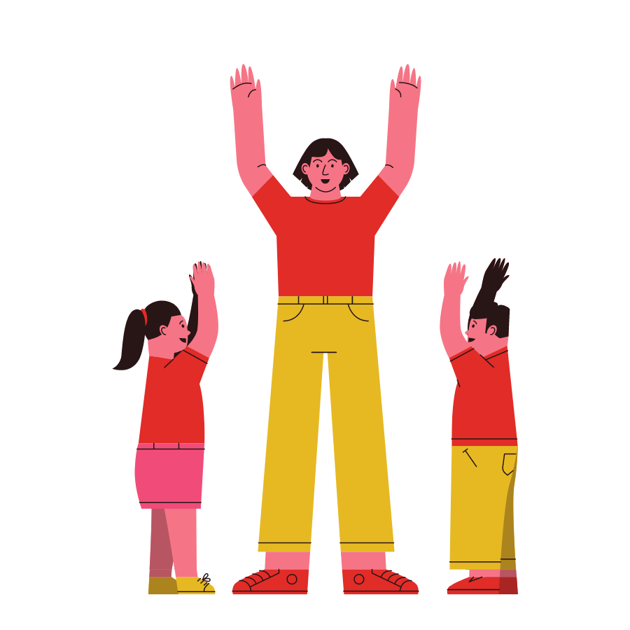
Your role as the assessor
Have sufficient knowledge & experience to:
Consider the welfare of everyone in your group: adults and children.
Take account of children’s changing needs and aptitude as they grow and develop.
Should be mindful of needs resulting from disability that may make some children and adults more vulnerable than others.
Identify and examine each hazard and determine the level of risk.
Identify and examine the control measures and determine whether they are adequate.
Where controls are found to be inadequate, recommend improvement actions.

Slide 6

What is a hazard?
Physical | Something that can cause harm with contact. They include excessive noise, heights, radiation, electricity and pressure.
Biological | A biological substance that can cause harm to a living organism, primarily people. They include viruses, bacteria, insects, rodents and harmful plants.
Chemical | Exposure to a chemical substance that can cause harm either to a person (e.g. burns, respiratory distress) or to another material (e.g. corrosion).
Environmental | The potential for an activity to cause damage to the natural environment.
Ergonomic | Anything that might cause stress, strain, harm or injury to a person’s body. This might be the poor set-up of an activity area, repetitive physical actions over a long period of time or manual handling.
Psychosocial | Anything that might harm the health, wellbeing or mental health of a person. This might include bullying, occupational stress, micro-aggressions, violence, etc.

Slide 7
What hazards come to mind?
Physical
Biological
Chemical
Environmental
Ergonomic
Psychosocial
Trips, slips, burns, cuts
Virus, vermin, insects, poisonous plants, food poisoning
Think about your venue and any activities that you undertake during a YAC session.
What types of hazards immediately pop into your mind?
Ingestion, burns, corrosion
Pollution, litter
Manual handling
Bullying, mental wellbeing, violence

Slide 8

Deciding on the risk
Risk has two parts:
Consequence / Severity – what’s the consequence?
Likelihood – how likely is it to happen?
We give each of these a rating of 1–5.

Slide 9

Deciding on the risk
Consequence (Impact of risk)
1 Insignificant (discomfort, slight bruising, self-help recovery)
2 Minor (small cut, abrasion, basic first aid need)
3 Moderate (strain, sprain, incapacitation > 3 days)
4 Major (fracture, hospitalisation >24 hrs, incapacitation >4 weeks)
5 Catastrophic (death)
Likelihood that a risk will occur:
1 Very unlikely (almost never)
2 Unlikely (might occur but rare)
3 Fairly likely (could occur but uncommon)
4 Likely (infrequently occurs)
5 Very likely (regularly occurs)

Slide 10
Deciding on the risk
Consequence (Impact of Risk) | 5 |  | 5 | 10 | 15 | 20 | 25
 | 4 |  | 4 | 8 | 12 | 16 | 25
 | 3 |  | 3 | 6 | 9 | 12 | 15
 | 2 |  | 2 | 4 | 6 | 8 | 10
 | 1 |  | 1 | 2 | 3 | 4 | 5
 |  |  | 1 | 2 | 3 | 4 | 5
 | Likelihood that a risk will occur
Risk rating |  | Action
1-2 Green |  | No action – no further action but ensure controls are maintained and reviewed.
3-6 Green |  | Monitor - look to improve at the next review or if significant changes.
8-12 Amber |  | Action - within a specific time frame (usually within 3 months).
15-16 Red |  | Urgent Action - take immediate action and stop activity if required, maintain controls.
20-25 Red |  | Stop Activity - take immediate action to minimise risks.
The Risk Rating = Consequence/Severity X Likelihood

Slide 11

Identifying control measures
Control measures should meet basic legal requirements and show best practice.
They might include:
Eliminating the hazard at source.
Reducing the hazard at source.
Removing the person from hazard.
Containing the hazard by enclosure.
Reducing employee / visitor exposure.
Putting in place systems of work, e.g. instructions, supervision.
Providing Personal Protective Equipment (PPE).

Slide 12
Putting it all together
The Session Plan and Risk Assessment template has been created to support you.
The table is set out as below.
Each branch is different so please ensure that you complete and amend the template for your needs.
Hazard | Who might be harmed? | Conse-quence | Like-lihood | Score (CxL) | Current precautions | Potential additional precautions | Person responsible
What might cause injury and/or harm to someone? | Anyone who might be affected | See accompanying matrix |  |  | What have you already put in place to limit the impact and likelihood of it happening? | What else might you do and when? (this might not be necessary if the score is very low. | A named Leader or Volunteer

Slide 13

Review
All risk-benefit assessments should be dynamic, by being:
Reactive to changing situations and conditions.
Reviewed at least annually, or when any changes occur.
Reviewed after an activity if it’s new to you, you noticed some aspects that could be done better/ more safely or if an accident/incident occurred.

Slide 14

Sharing this information with volunteers
There are many ways in which all YAC volunteers can be involved in the risk management for your branch and sessions.
Some ideas are:
Write your session plan and risk-benefit assessment collaboratively or take it in turns to do this.
Send your session plan and risk-benefit assessment to all the branch volunteers for comments before the session.
Ensure that the session plan and risk-benefit assessment is available to all volunteers at the session.
Hold a pre-session briefing to go over the activities and key control measures.
Discuss any thoughts, incidents or near misses after the activities/session to improve safety in the future.

Slide 15
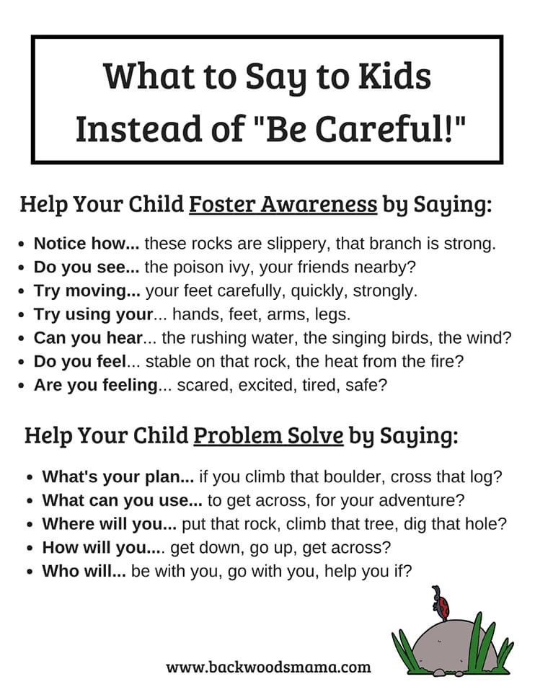
Sharing this information with children
Consider what role you would like your members to have in risk management and how their involvement will help them grow and learn.
Top tips include:
What kind of language are you using? Can you use descriptive instruction or questions to foster awareness or questions to help them problem solve?
Explain the reason why something can’t be done, especially if they could do it another time (e.g. you might slip on wet wood if you climbed a tree in the rain).
Tailor your language to the age and ability of your members.

Slide 16

Sharing this information with parents/carers
There will be times when parents/carers will require additional information regarding control measures. This might be around attendance and illness or about special activities such as a field trip or cooking.
Some ideas are:
Send a letter/email to all parents/carers
Have a chat with them at the beginning or end of the session, especially if there might be special considerations (e.g. allergies)
Display a simple poster where parents/carers can see it easily and clearly
Always be prepared to answer questions, be open to feedback and to share risk assessments if requested.

Slide 17

Activity
What can you see?
Using a YAC activity photograph, answer the following questions:
What hazards are there?
What’s the risk?
What control measures are in place or that you would put in place?
Would you change anything next time?
You may like to use a session plan and risk-benefit assessment template to record your thoughts.

Slide 18
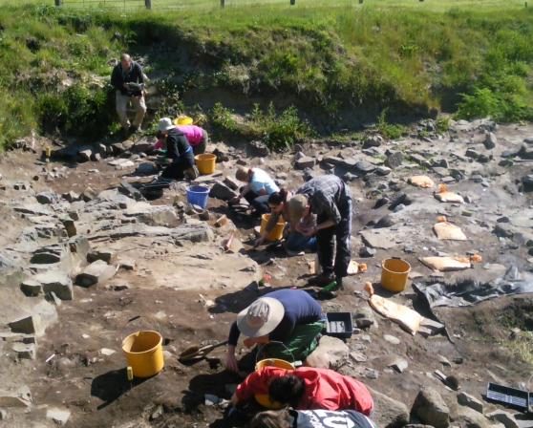
What can you see?
What hazards are there?
What’s the risk?
What control measures are in place or that you would put in place?
Would you change anything next time?

Slide 19
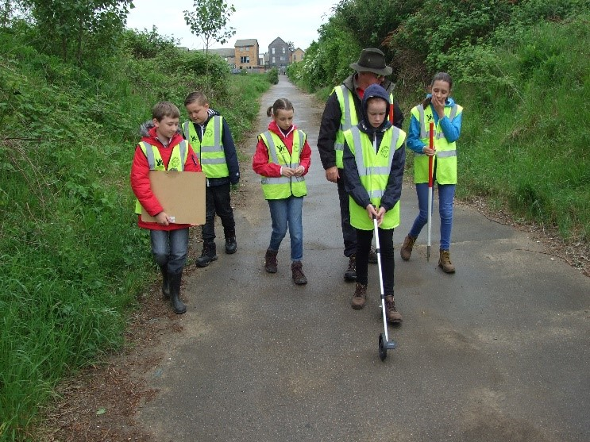
What can you see?
What hazards are there?
What’s the risk?
What control measures are in place or that you would put in place?
Would you change anything next time?

Slide 20
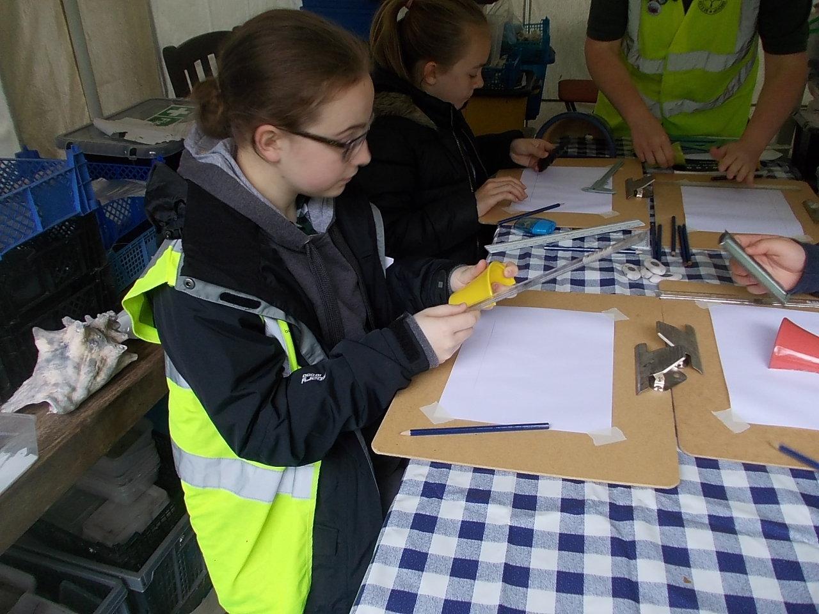
What can you see?
What hazards are there?
What’s the risk?
What control measures are in place or that you would put in place?
Would you change anything next time?

Slide 21
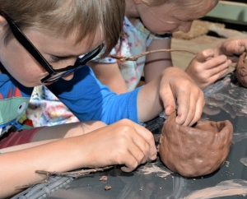
What can you see?
What hazards are there?
What’s the risk?
What control measures are in place or that you would put in place?
Would you change anything next time?

Slide 22
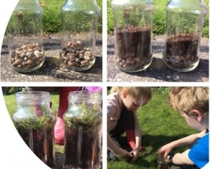
What can you see?
What hazards are there?
What’s the risk?
What control measures are in place or that you would put in place?
Would you change anything next time?

Slide 23
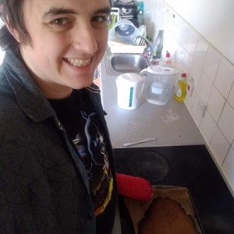
What can you see?
What hazards are there?
What’s the risk?
What control measures are in place or that you would put in place?
Would you change anything next time?

Slide 24
Where to get help
YAC HQ
HSE: Information about health and safety at work - Health and safety at work in Scotland (hse.gov.uk)
HSE - Working with Wales: HSE in Wales
Home | Health and Safety Executive Northern Ireland (hseni.gov.uk)
Local environmental health

