Slide 1

Activity
What can you see?
Using a YAC activity photograph, answer the following questions:
What hazards are there?
What’s the risk?
What control measures are in place, or would you put in place?
Would you change anything next time?
You may like to use a session plan and risk assessment template to record your thoughts.

Slide 2
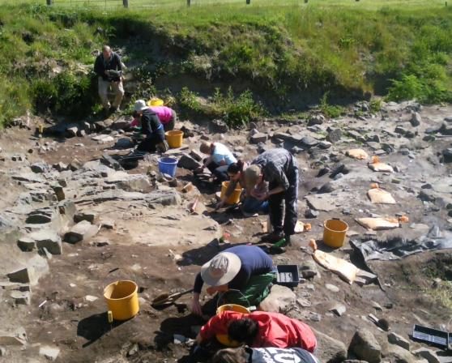
What can you see?
What hazards are there?
What’s the risk?
What control measures are in place or that you would put in place?
Would you change anything next time?

Slide 3
What can you see?
What hazards are there?
Tools, uneven ground, sun & heat, manual handling, soil contamination, trip hazards, slips, position of body while digging…
What’s the risk?
Cuts, sprains, sunburn, heat stroke, muscle strain, slips, trips…
What control measures are in place or that you would put in place?
Knee pads, sun hats, regular breaks, safety talk at the beginning of the day, good housekeeping…
Would you change anything next time?
This is not a definitive list and is provided to give an example.

Slide 4
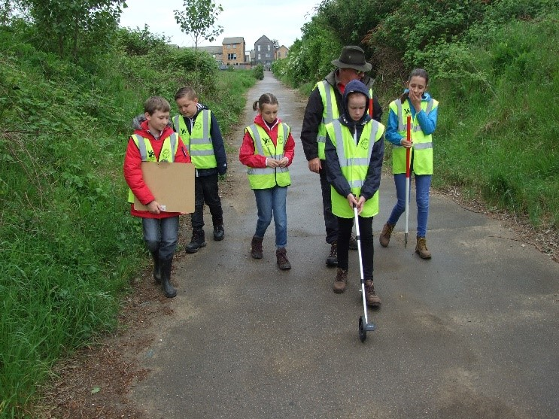
What can you see?
What hazards are there?
What’s the risk?
What control measures are in place or that you would put in place?
Would you change anything next time?

Slide 5
What can you see?
What hazards are there?
Trip hazards, other pathway users, inclement weather (cold?)…
What’s the risk?
Falling over, tripping on equipment, being cold over a long period, lost children…
What control measures are in place or that you would put in place?
Hi-vis jackets, sensible shoes, pathway with no vehicular access, adult supervision…
Would you change anything next time?
This is not a definitive list and is provided to give an example.

Slide 6
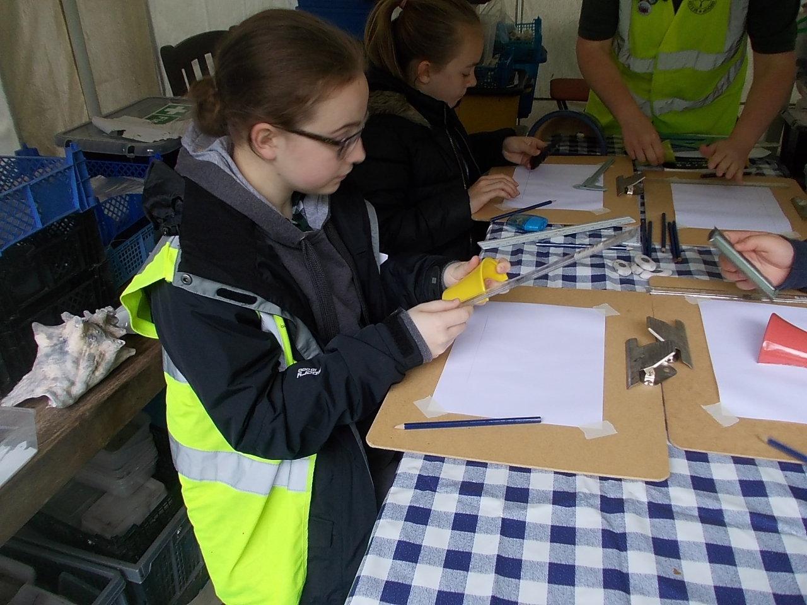
What can you see?
What hazards are there?
What’s the risk?
What control measures are in place or that you would put in place?
Would you change anything next time?

Slide 7
What can you see?
What hazards are there?
Trip hazards, broken pots, stacked boxes, narrow pathway between storage and activity table…
What’s the risk?
Cuts, tripping on stored items, stored items falling…
What control measures are in place or that you would put in place?
Stored items stacked neatly and securely, adult supervision, clear guidance on activity, preparation of materials…
Would you change anything next time?
This is not a definitive list and is provided to give an example.

Slide 8
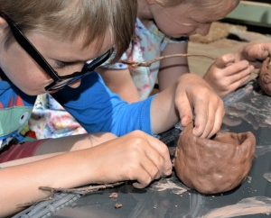
What can you see?
What hazards are there?
What’s the risk?
What control measures are in place or that you would put in place?
Would you change anything next time?

Slide 9
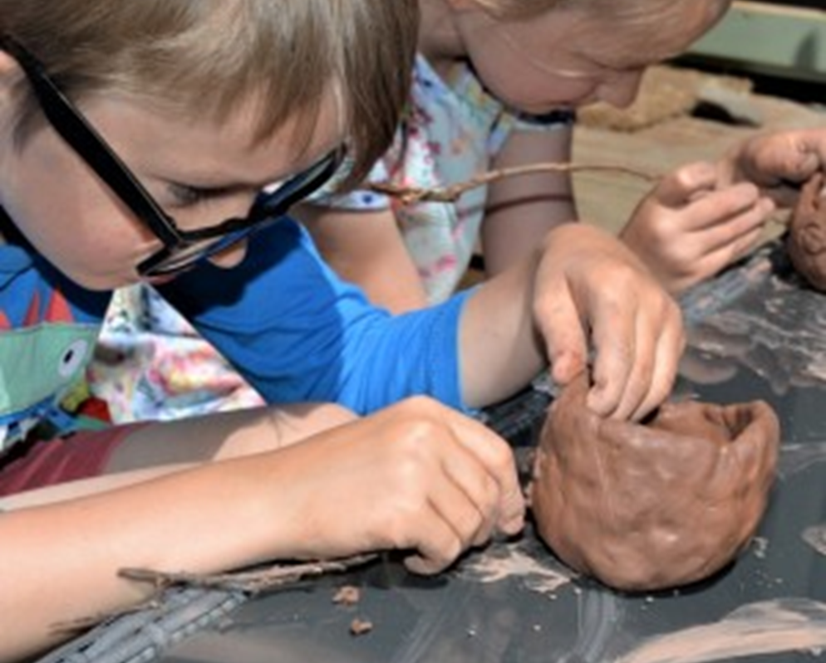
What can you see?
What hazards are there?
Clay, sticks…
What’s the risk?
Allergies, stick breaking & causing cuts or going in eyes, ingestion…
What control measures are in place or that you would put in place?
Vinyl gloves available for anyone with sensitivity to clay, parental consent forms with known allergy information, clear activity instruction, adult supervision…
Would you change anything next time?
This is not a definitive list and is provided to give an example.

Slide 10
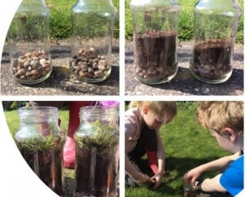
What can you see?
What hazards are there?
What’s the risk?
What control measures are in place or that you would put in place?
Would you change anything next time?

Slide 11

What can you see?
What hazards are there?
Glass jars, working outside, small sharp flints in soil…
What’s the risk?
Falling over, breaking the jar and cuts, hands getting stuck in the jars, lost children…
What control measures are in place or that you would put in place?
Sensible shoes, contained area chosen, clear instructions, adult supervision…
Would you change anything next time?
This is not a definitive list and is provided to give an example.

Slide 12
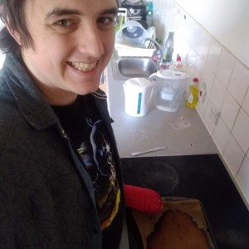
What can you see?
What hazards are there?
What’s the risk?
What control measures are in place or that you would put in place?
Would you change anything next time?

Slide 13
What can you see?
What hazards are there?
Kettle, hot pan, washing up liquid, cleanliness, glass bottles, food made…
What’s the risk?
Burns, allergies (washing up liquid & food), contamination of food, broken equipment…
What control measures are in place or that you would put in place?
Oven gloves, cleaning materials, electrical sockets in good repair…
Would you change anything next time?
This is not a definitive list and is provided to give an example.

