Slide 1

Using Portable Electrical Equipment
The use of Portable Electrical Equipment may be required as part of an activity (e.g. an iron or laminator) or daily operation (e.g. a laptop or kettle). As part of the safe use of these items, it’s important that YAC leaders and volunteers understand how to carry out a before-use check, use electric tools safely and recognise potential hazards.

Slide 2
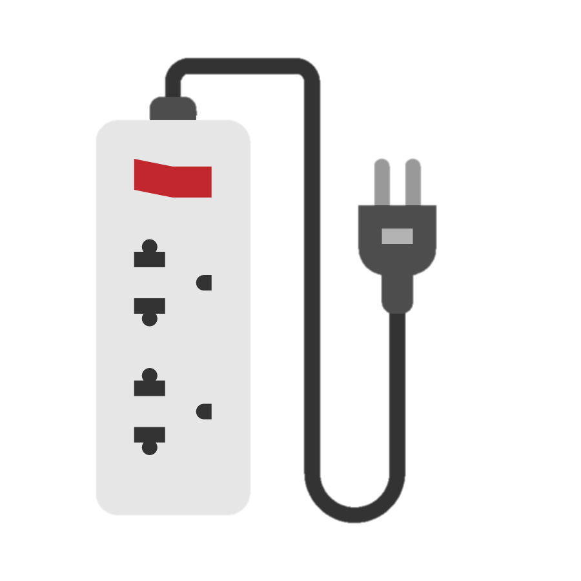
Before-use checks
80% of faults with electrical equipment are found before use.
To help you to work safely:
Make sure the casing isn’t damaged – if it is, don’t use it.
Make sure that all cables, plugs or connectors are sound and not damaged.
Use tools connected to a power supply as instructed on the maker’s label.
Ensure the tool is properly earthed unless it is an approved type that does not require earthing.

Slide 3
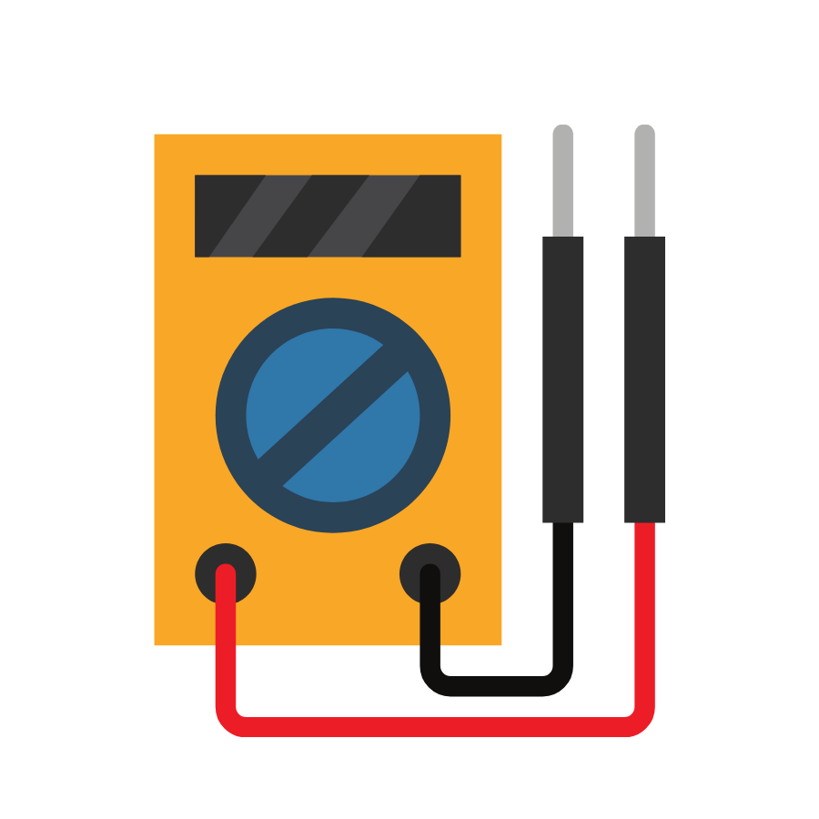
Before-use checks contd.
Ensure the cable is long enough to reach your work without straining it.
Is this the most suitable equipment to use for the job?
How has it been stored? Unsafe storage conditions may cause potential hazards.
Where portable appliance testing has been carried out check the appliance’s test label indication, this will indicate if it has a PASS or FAIL status.
If an inspection and testing show the appliance is faulty, do not use it.

Slide 4
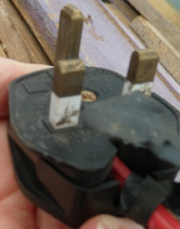
Potential faults that you might see, hear or smell
Plugs:
Cracked casing, bent pins (see photo)
Incorrectly rated fuse
Incorrectly connected wires
Loose connections
Loose cable clamp
Non-standard plug (see photo of a standard UK plug)

Slide 5
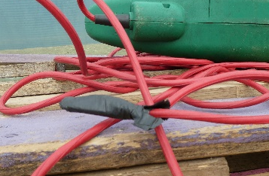
Potential faults that you might see, hear or smell
Mains lead:
Cuts, fraying or brittle
Kinked or coiled
Taped joints (see photo ª)
Overloaded (overheated)
Not secured by grommet/clamp on appliance - if mains lead is non-detachable (see photo ^{b})
b
a

Slide 6
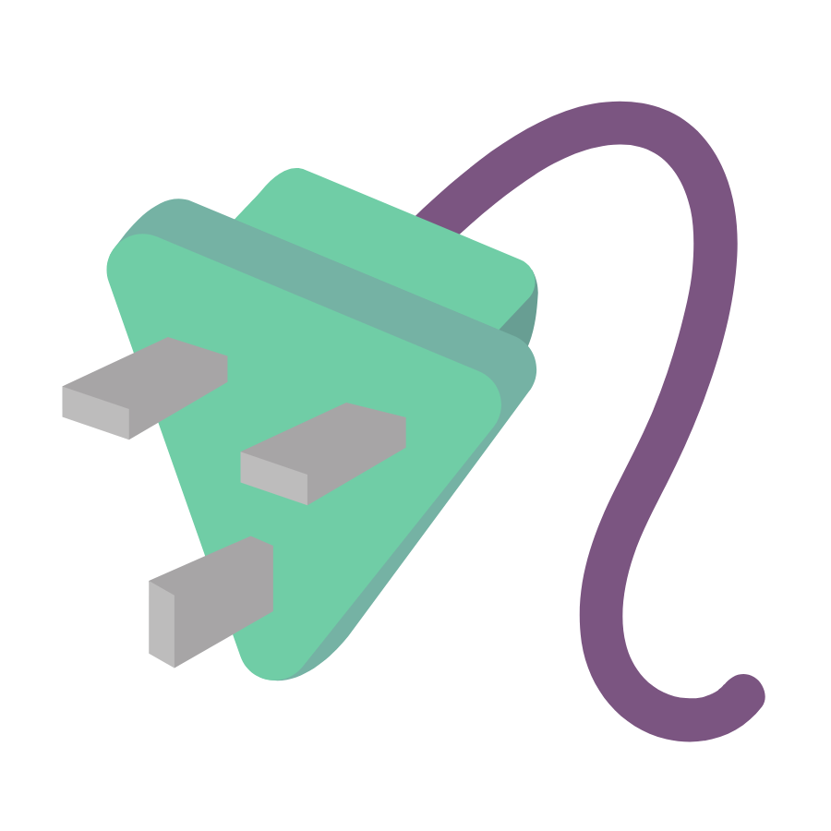
Potential faults that you might see, hear or smell
Evidence of moisture
Missing double insulation mark on insulating casing (where appropriate)
Accessible fuse holders: damage or removal of carrier that permits live part to be touched
Exposed output connections have marked voltage rating > 50V
Appliance:
Damage or faulty operation of on/off switch
Damage to casing
Loose parts
Missing screws
Evidence of overheating

Slide 7
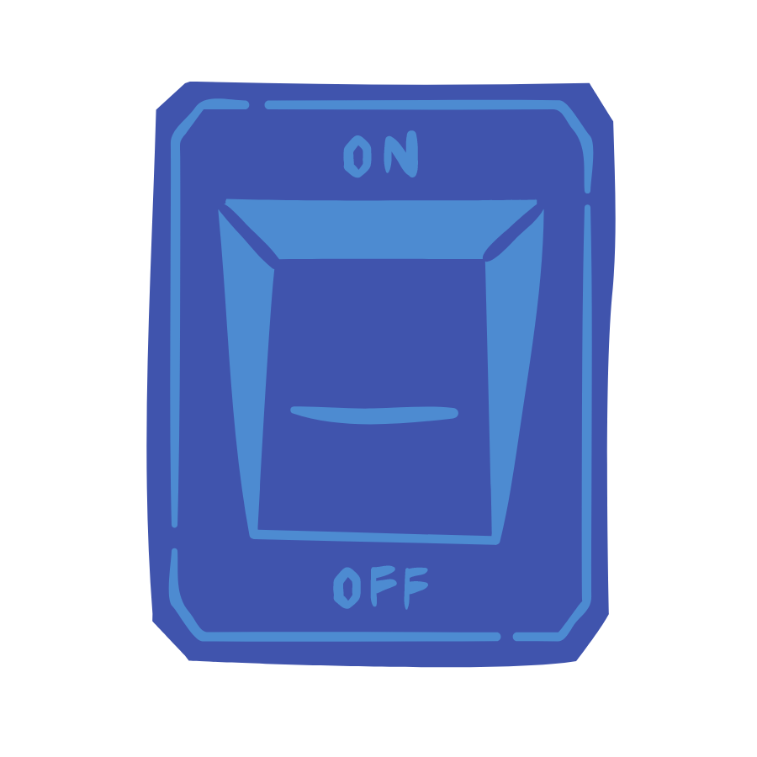
Using portable electric tools and equipment
Portable electric tools and equipment should only be used for their designated purposes.
Ensure switches are working correctly before connecting to the power supply.
Wear eye protection if there is any risk to your eyes.
Disconnect tools and equipment when not in use.
Electric power tools and other equipment/appliances should be regularly inspected and maintained by a competent electrician.
During use, if there are other signs of faults (e.g. sparking, sounds of crackling or smells of burning), it is unsafe and must be taken out of service until remedial action is taken.

Slide 8
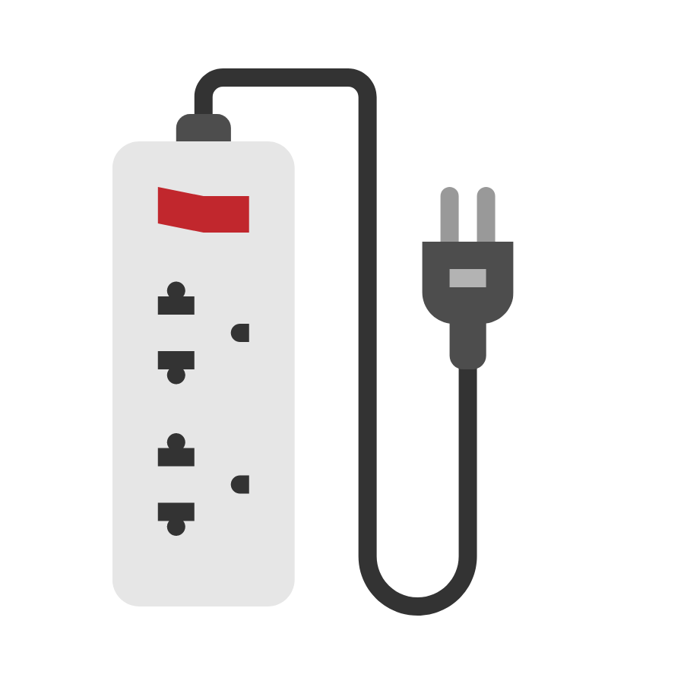
Potential hazards to consider
Keep power cables off the floor. They may get damaged or cause someone to trip. If they need to be on the floor, use a protective covering over them.
Electrical tools often present a noise hazard – wear ear protection if necessary.
Avoid standing on a damp or wet surface when using electrical equipment.
Keep equipment clean and dry.
Never connect a portable electric tool to a lighting socket.
Don’t use blunt, worn or damaged bits and accessories.
If using them outside, do you require a waterproof socket cover or shelter?
Portable electrical tools & equipment, which have become wet, should be allowed to dry then checked by a competent person for electrical safety before being reused.
How suitable is the storage of the equipment? For example, dusty or damp conditions are not safe storage conditions and may cause potential hazards.

Slide 9
Remember …
Under no circumstances should you use electrical apparatus if you have any doubts about its safety.
All faults and doubts of electrical safety should be reported to the YAC leader or, if appropriate, the venue operator.

