Slide 1

Manual Handling
Whether you are moving boxes of equipment from your car to the venue, setting up tables and chairs or working on an excavation site, good manual handling is important to limit injuries.

Slide 2
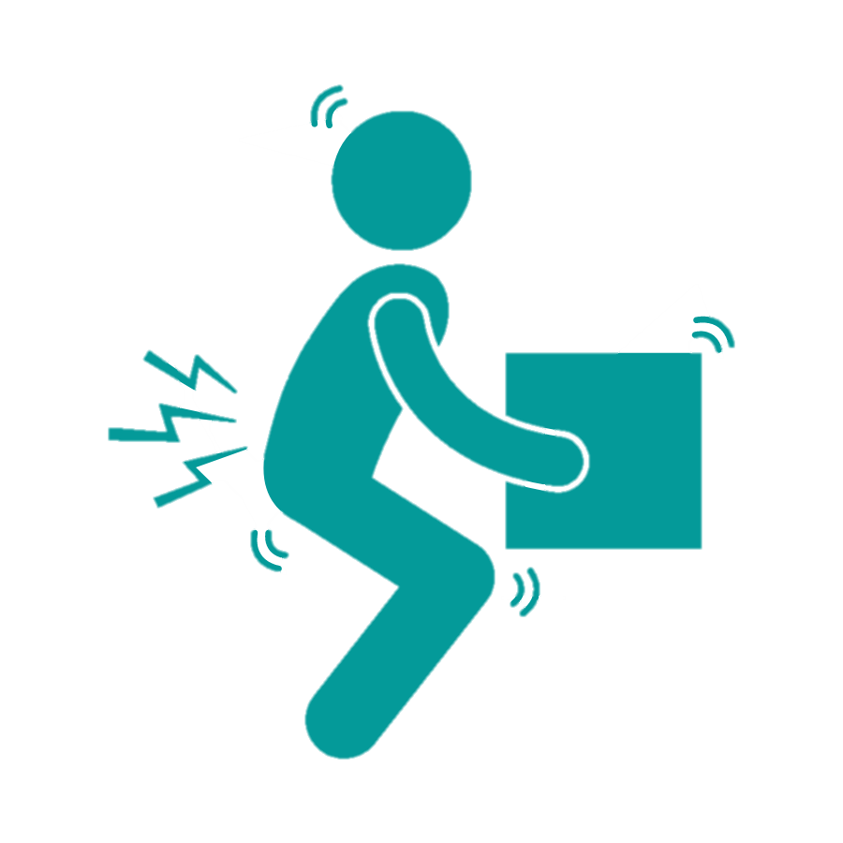
Why we need to be aware of good manual handling procedures
Lifting, pulling and pushing objects, especially heavier items is part of most people's day to day life. However, it is estimated that 1 in 3 accidents at work are due to poor manual handling.
Manual handling injuries are part of a wider group of musculoskeletal disorders (MSDs).
They can be:
short term e.g. cuts, bruises, strains, sprains and small fractures or
long term e.g. Muscle, tendon, joint or nerve damage

Slide 3
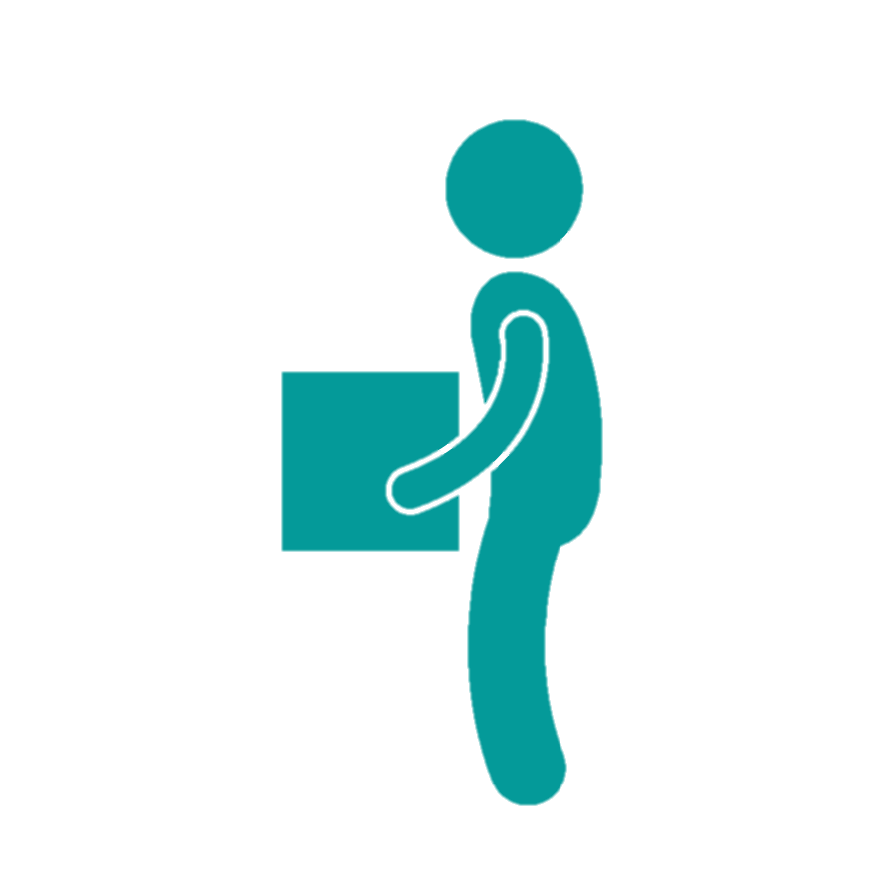
Considerations for manual handling
Always use mechanical handling methods instead of manual handling, if possible, e.g. sack barrows.
Know your capabilities; only tackle jobs that you can handle.
Can you handle the load yourself, or do you need assistance?
Is there a clear walkway with good lighting to the work area?
Where possible, establish the weight of the load before lifting.
Wear gloves to protect against cuts and punctures.
Wear sensible footwear (e.g. safety boots) to protect from falling loads.
Carry out a trial lift by rocking the load from side to side, then try lifting it in a small amount to get a ‘feel’ for it.

Slide 4
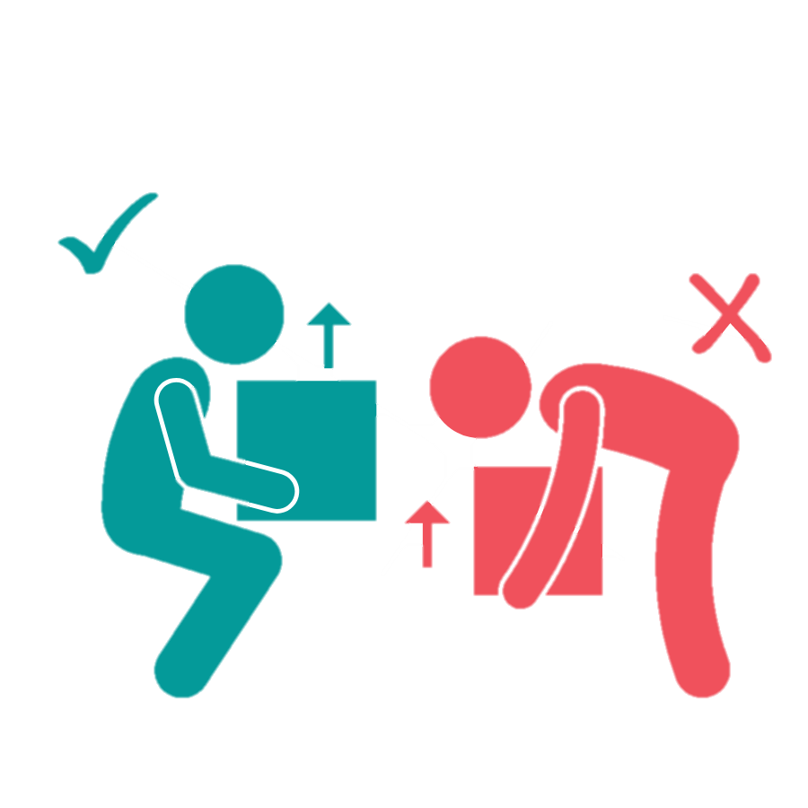
Good handling technique
Stand reasonably close to the load, feet hip-width apart, one foot slightly forward pointing in the direction you’re going.
Bend your knees and keep your back straight.
Get a secure grip on the load.
Breathe in before lifting as this helps to support the spine.
Use a good lifting technique, keep your back straight and lift using your legs.

Slide 5
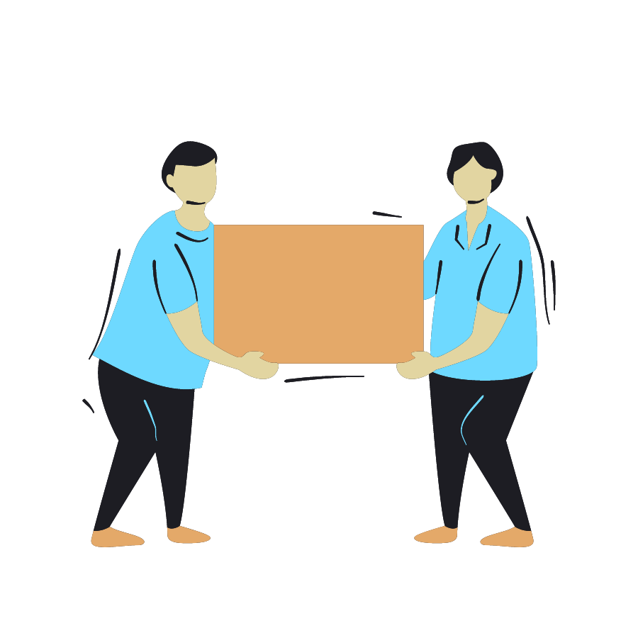
Good handling technique contd.
Keep the load close to your body.
Don’t carry a load that obscures your vision.
Lift slowly and smoothly.
Avoid jerky movements.
Avoid twisting your body when lifting or carrying a load.
When lifting to a height from the floor, do it in two stages.
When two or more people lift a load, one person must take control to co-ordinate the lift.

