Slide 1

Fire Safety
When running a session, it is important that YAC leaders and volunteers understand the principles of fire safety.
General housekeeping
Potential sources of fuel
Potential ignition sources
What to do in a fire emergency

Slide 2
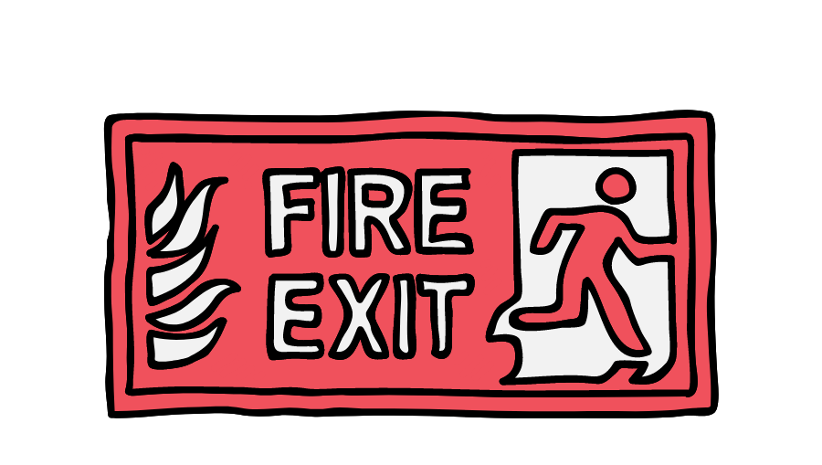
General Housekeeping: what you should consider
Escape routes and firefighting equipment
Know your regular venue, where fire exits and assembly points are and where emergency equipment is kept
Keep fire escapes clear and report any that are obstructed
Check that fire exits can be easily and immediately opened
Report any fire doors that have been wedged open
Report any fire safety signs that have been obstructed
Report any emergency lights which are not working
Report any missing, damaged or obstructed fire extinguishers and fire blankets

Slide 3

General Housekeeping: what you should consider
Attendees to your YAC session
Ensure that a session register is kept so that members, volunteers and visitors can be accounted for in the event of a fire
Explain how anyone attending a YAC session can raise the alarm and how to recognise the alarm signal
Ensure that all YAC leaders and volunteers know the specific emergency evacuation plan, the fire escape routes and the location of fire exits and assembly points.

Slide 4

General Housekeeping: what you should consider
Preventing deliberate fires
Follow the locking up procedure, especially if you are the last to leave, including securing doors and windows, switching off heaters, etc.
Immediately report any security risk, such as damaged windows, doors and fences
Report any faults, damage or obstruction to security equipment such as security lighting
Supervise attendees at your session at all times
Report suspicious behaviour
Keep combustible or flammable materials well away from buildings

Slide 5

Typical sources of fuel
Waste materials
Dispose of rubbish and waste regularly and safely, preferably using secured, lidded containers kept at a safe distance from the building and boundary fences and walls
Regularly check hidden areas and storage areas for accumulated rubbish
Separate hazardous waste into clearly labelled containers
Combustible and flammable materials
Report or remove any combustible materials placed dangerously close to sources of heat, such as heaters, lighting and heat-generating equipment
Store flammable liquids in a locked store, away from any source of ignition or heat and ensure only minimum quantities as required for the activity are brought to the session
Storage of flammable gases should be minimised

Slide 6

Typical sources of ignition
Discarded smoking materials and matches
Ensure that smoking only takes place in designated areas outside the buildings
Ensure that cigarettes are completely out before they are discarded and, if possible, dispose of them in a metal receptacle
Hot Work
Plan activities that include additional heat sources (e.g. an iron, hot enamelling) carefully and ensure that any additional safety equipment or instructions are recorded in the session plan and risk assessment
Cooking equipment
Ensure all heated surfaces are clean, clear of grease, packaging, food residue and other combustible materials, such as tea towels

Slide 7

Typical sources of ignition
Electrical and process equipment
Report any damaged electrical fittings and cables
Report any flickering lights
Ensure electrical equipment is periodically inspected and maintained
Avoid overloading circuits and overheating equipment
Avoid using unprotected trailing leads
Avoid using adaptors where possible
Switch off electrical and process equipment at night (unless in constant use)

Slide 8
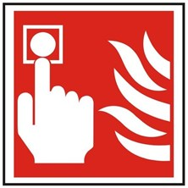
Action in the event of a fire
Raise the alarm If you discover a fire, raise the alarm by shouting ‘FIRE’ and breaking the glass of the nearest fire alarm call point
Call the fire brigade
Dial 999 and ask for the fire brigade
Tell the operator:
The location (address) and severity of the fire
Whether people are trapped on the premises and whether highly flammable or hazardous substances are involved
Don’t hang up until the operator has confirmed the details.

Slide 9
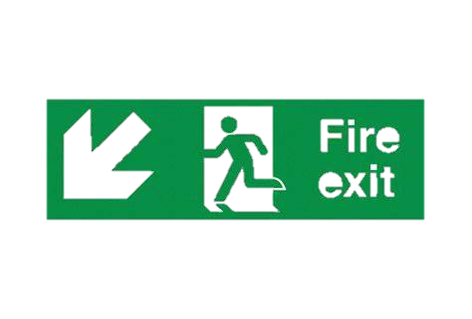
Action in the event of a fire
Leave the building by the nearest exit. If the closest escape route is blocked by smoke, use the nearest alternative route.
Ensure everyone around you is aware of the fire and help everyone who needs assistance to leave the premises.
Close, but do not lock, doors behind you as you leave and report to your designated assembly point.
Take a session register (& let the emergency services know if anyone is unaccounted for).
Do not:
Risk your own life to save property
Stop to collect personal belongings
Use lifts
Re-enter the premises until advised by the fire brigade
or other authorised personnel that it is safe to do so
Make sure that you know what your emergency evacuation plan is!

