Slide 1


Chemicals and Hazardous Materials
Why we should be aware of chemicals and hazardous materials
Ten golden rules
The GHS pictograms
Where to get more information

Slide 2
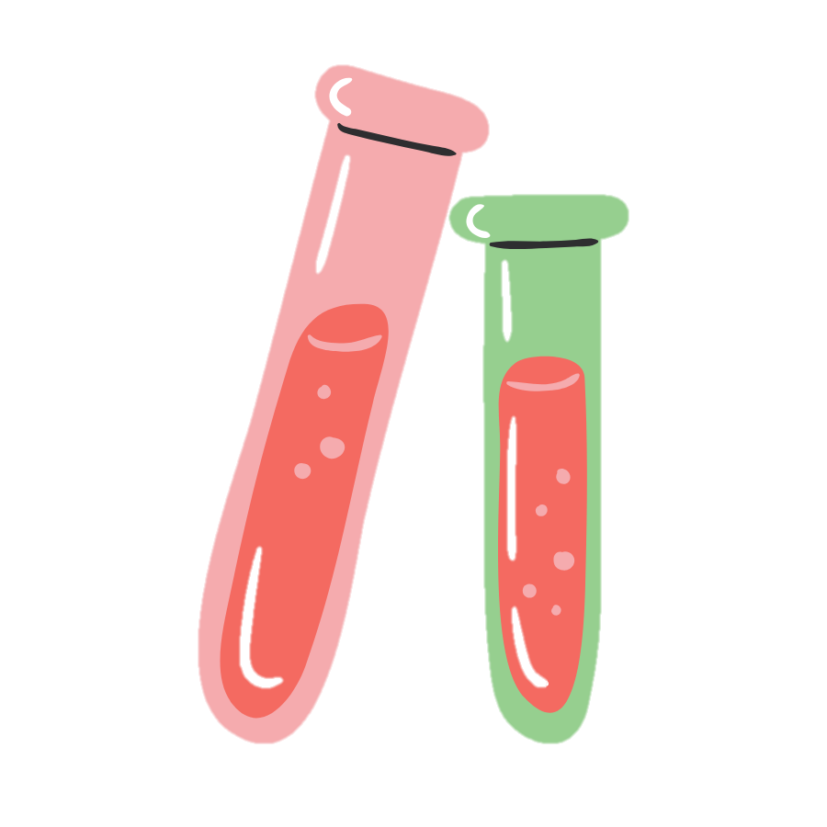
Why we need to be aware of chemicals and hazardous materials
We use chemicals all the time, whether that’s washing up liquid, poster paint, PVA glue, disinfectant cleaning spray, etc.
These products are safe to use unless used or stored incorrectly.
There may also be times when you might use, handle, or come across more hazardous chemicals and materials. This might be uncovering asbestos on an archaeological excavation or within artefacts. If you are planning an activity where there is the potential for this to happen, such as an archaeological excavation, please contact YAC HQ for further guidance.

Slide 3

The Ten Golden Rules
The following provides basic guidance for the common use of chemicals.
Read the label and follow the instructions; this includes understanding the hazard pictograms.
Choose items that are suitable for the job and the age and ability you are working with. Many arts and crafts products will have a ‘suitable for ages ... and above’ notice on the label.
Use protective clothing if required (e.g. gloves, aprons).
Only mix chemicals where it is a clear requirement for the activity, e.g. science experiments, cyanotype, dyeing, and where clear instructions and guidance have been provided. Never mix cleaning materials or other chemicals, as mixing chemicals can kill.
Store all chemicals safely and, where applicable, out of reach of children, e.g. cleaning chemicals.

Slide 4

The Ten Golden Rules contd.
Never put chemicals into unmarked containers or containers that have other uses, e.g. eating or drinking.
Be sure that you know how to deal with spills (including first aid treatment) and the correct disposal of the chemical.
Be aware of more hazardous materials that might be found on an archaeological excavation or in a historic artefact and seek support from the partners you are working with.
Always follow the safety rules and develop safe working practices at your sessions.
Report anything wrong to the YAC leader.

Slide 5
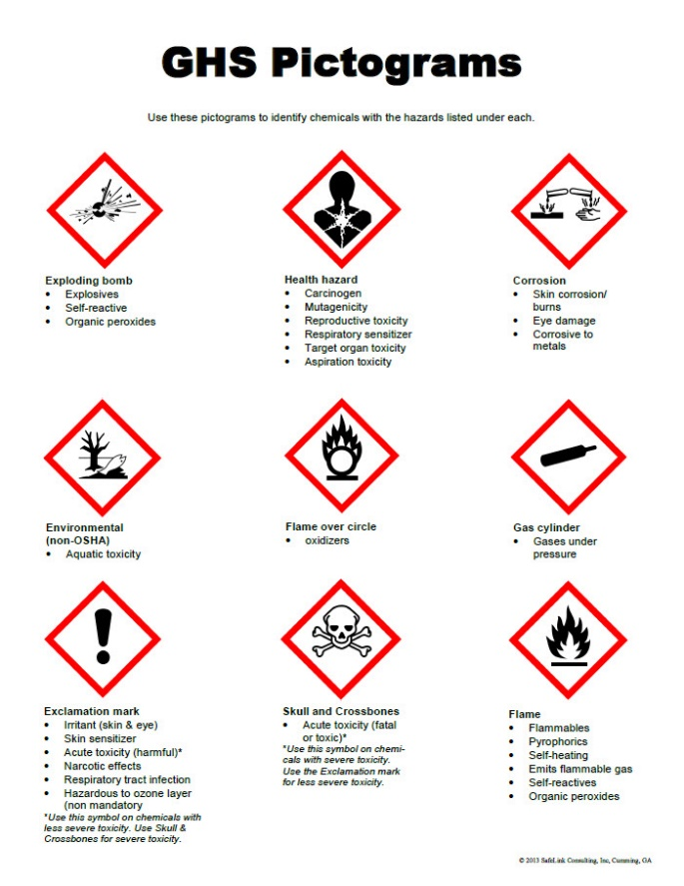
The GHS Pictograms
These hazard pictograms form part of the international Globally Harmonized System of Classification and Labelling of Chemicals (GHS). Two sets of pictograms are included within the GHS: one for the labelling of containers and for workplace hazard warnings, and a second for use during the transport of dangerous goods.
These are the specific pictograms for the labelling of containers and for hazard warnings.

Slide 6

Where to get information and help
Always check the labels.
Do an internet search for, read, and download the relevant ‘Safety Data Sheet’ which provides additional information about the chemicals being used and any first aid requirements.
Ask YAC HQ or an activity partner.
If you think someone has ingested something that might cause harm (where no immediate allergic or other medical reaction has occurred), call 111 for advice.

